Slide 1


TOPIC: E-mail, Social Networking and e-Governance Services
COURSE: CCC Concepts
CHAPTER: E-mail, Social Networking and e-Governance Services
DAY: 37
Presentation By: Shruti Dubey

Slide 2
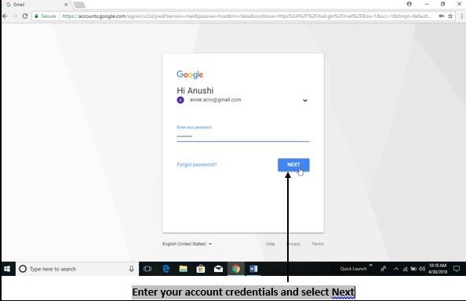
(iii) Creating and Sending a new E-mail
In order to send a new text message to the user, first create or compose the message which includes the following steps.
Step 1 − Open your mail account by providing correct User name and Password.

Slide 3
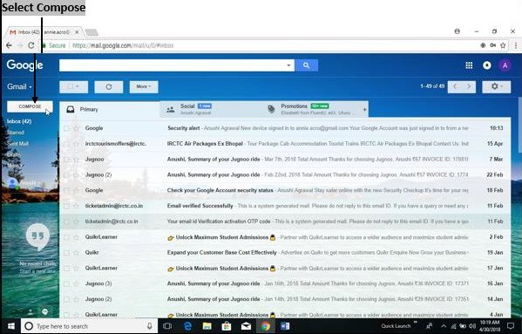
Step 2 − Compose or create your message by selecting "compose" option shown in the window.

Slide 4
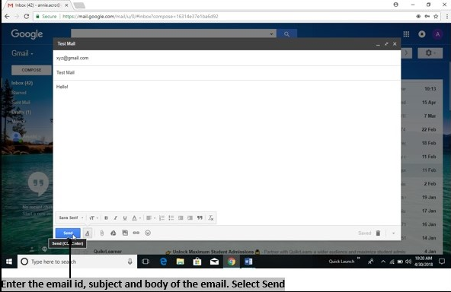
Step 3 − In the window displayed, enter recipient’s address in "To" textbox and add "Subject" of message, then add a "Body" of the message and press "Send" button. Remember, the subject of the mail should be explicit and short.

Slide 5
(iv) Replying to an E-mail message
Replying is giving response to the received mail which includes the following steps.
Step 1 − Open an email to which you want to reply and press the "Reply" button or press "Shift+R" on the keyboard.
Step 2 − In the window displayed, enter "Body" of the mail and click "Send" button. The mail will be sent automatically to the corresponding person without having to re-type the "To" address.

Slide 6
(v) Forwarding an E-mail message
Forwarding is a process of resending an email message that you received from another email id. This option saves time as the user doesn’t have to re-type the same message again. It includes the following steps.
Step 1 − Open the email which you want to forward and click on "Forward" option or press "Shift + F" on the keyboard.
Step 2 − In the window displayed, enter the recipient address in "To" textbox and press "Send" button. The mail will be forwarded to the corresponding person.

Slide 7
(vi) Searching emails
Searching email is a process of finding the desired email without going through all the emails.
Step 1 − Type the name, email id or key-term in the search box displayed on top of the window.
Step 2 − From the list of displayed mails, select desired mail or message.

Slide 8
(vii) Attaching files with email
Emails are a popular, effective, and fast way to communicate. Attaching a file to an email is an easy way to send important documents and/or photos. Below are a few simple steps that will walk you through the process of sending an email with an attachment in most email programs.
Step 1
Turn on the computer and log onto the internet.
Step 2
Type in the web address of your email host in the address bar and log onto your email account.
Step 3
Click on "Compose" to write a new email.
Step 4
Click on the icon to attach a file. This icon appears as a paperclip symbol in most email programs. After you click on the icon to attach a file a box will pop up onto your screen.

Slide 9
Step 5
Browse the information on your computer my clicking on the folder that contains the file that you would like to attach. When you find the needed file, click on it and then click on "open." This will start the process of attaching the file to your outgoing email message.
Step 6
Read the directions on your computer screen. It will most likely say that the file was attached successfully.
Step 7
Write the text of your email, insert your recipient's email address and then click on "send."

Slide 10
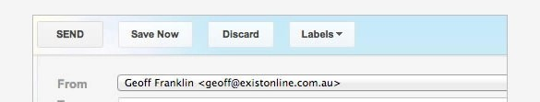
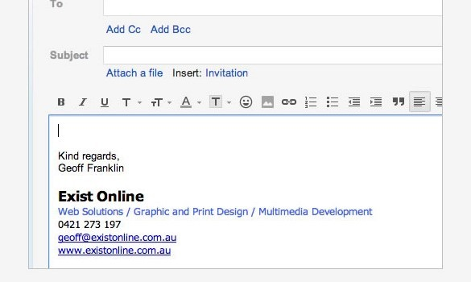
(viii) Email Signature
An email signature is text, like your contact information or a favourite quote, that's automatically added at the end of Gmail messages as a footer.

Slide 11
Thank you!
www.nielit.gov.in/haridwar

